Slide 1
INTRODUTION TO COMPUTER NETWORK

Slide 2
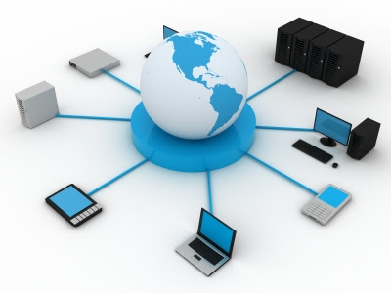
WHAT IS COMPUTER NETWORK
A Computer network is the interconnection of two or more computers. It is done to enable the computer to communicate and share resources.

Slide 3
Types of Network
Local Area Network ( LAN )
Wide Area Network ( WAN )
Metropolitan Area Network ( MAN )

Slide 4
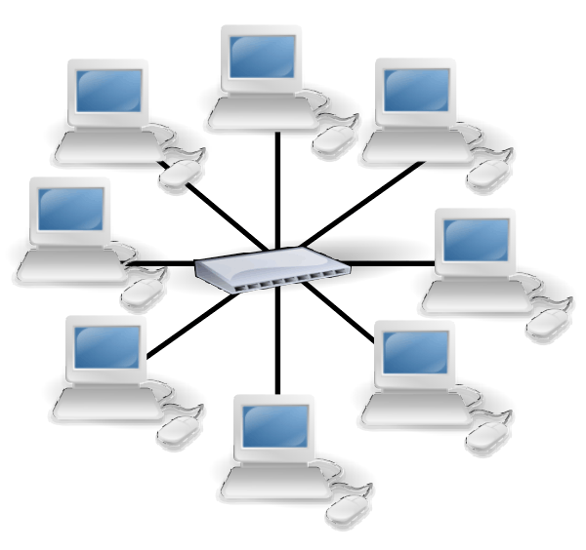
Local area network ( lan )
A Local Area Network or LAN is a network that connect computer within a limited area. This might be in a school, an office .

Slide 5
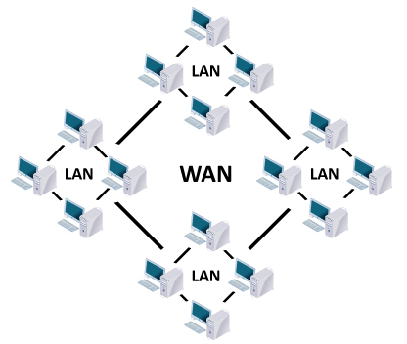
wide area network ( wan )
A Wide Area Network or WAN is a network that cover a larger geographical area , usually with a radius of more than a kilometer.

Slide 6
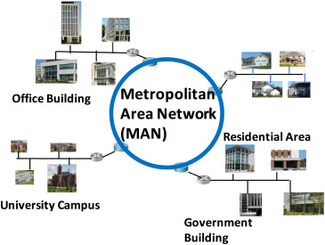
metropolitan area network (man)
A Metropolitan Area Network or MAN is a network that covers the entire city. A MAN is a series of connected LANs in a city, which might also connect to WAN.
It can be a single network such as cable TV network.

Slide 7
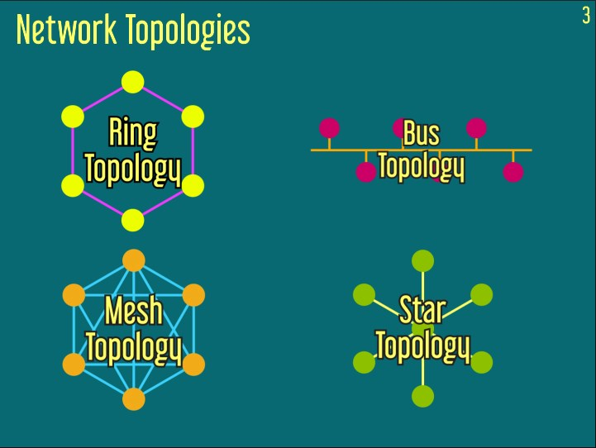
Network topology
A Network Topology is defines the way in which computer and devices are connected.

Slide 8
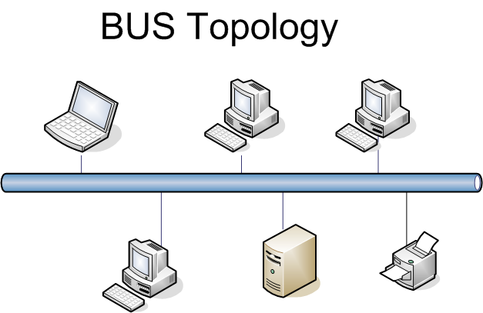
Bus topology
In a bus topology all the devices are connected by one single cable which is also called backbone.
Only one computer can send message at a time .

Slide 9
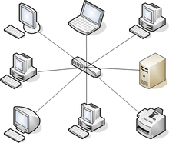
star topology
In a Star topology all the devices are connected with a central node.
Each computer has an independent connection to center of network and if one connection breaking won’t affect the rest of the network.

Slide 10
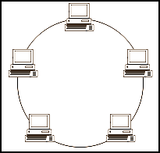
ring topology
A Ring Topology is network where device connections create a circular data path. Each device is connected to two others devices.
If one computer fails, whole networks fails.

Slide 11
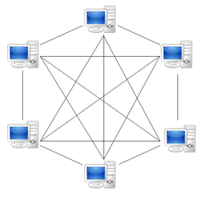
mesh topology
A Mesh Topology is network setup where each computer or devices are interconnected with one another.
This setup allows for transmission to be distributed even if one of the connection goes down.

Slide 12
Thank you

